Slide 1
INFO 6150 Final Project
Task Management Web App
Yidan Zhu
Fengyi Zhang

Slide 2
Introduction
A task management web app integrated note taking, to-do list, and local weather
Front-end: React, Bootstrap
Back-end: Node.js, Express, MongoDB
Tools: OpenWeatherAPI

Slide 3
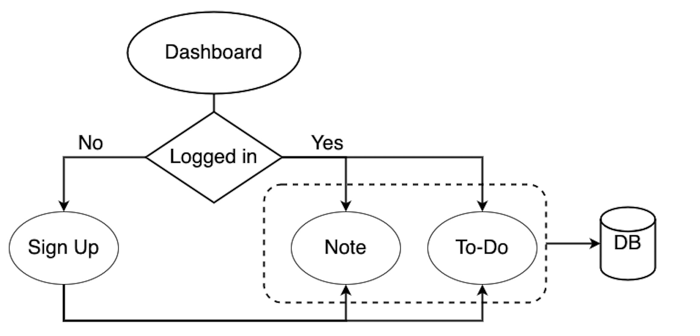
Structure

Slide 4
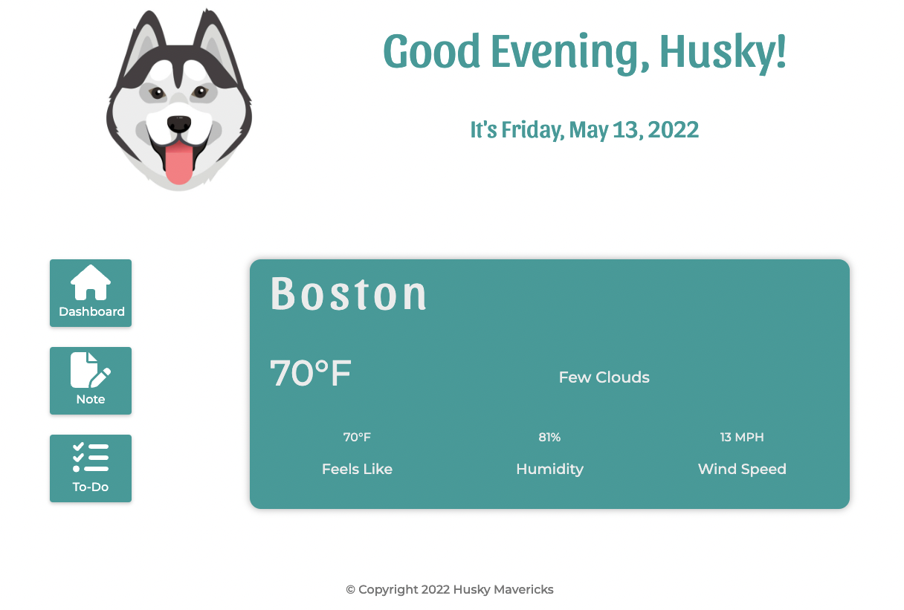
Dashboard
Homepage
If the user wants to go to the note page or to-do list, the login status will be checked first
The time of the day and the date will be reflected by local time
Local weather will be updated every time when refreshing the page

Slide 5
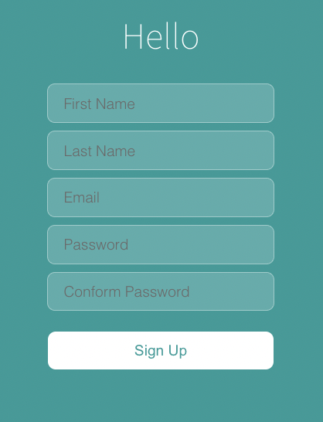
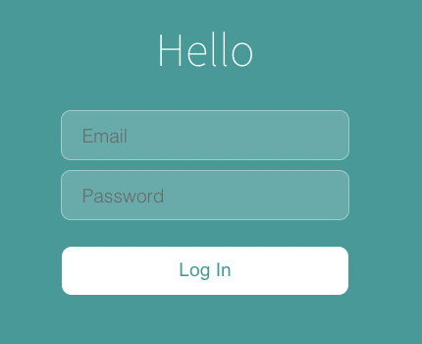
Log in/Sign up
Show the email and name of the user

Slide 6
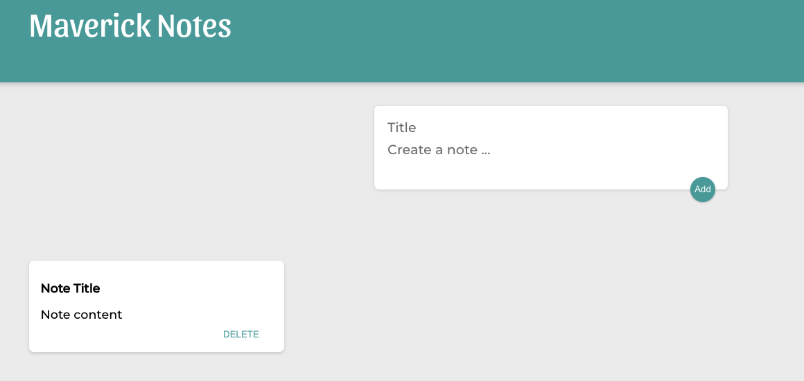
Note
Take notes

Slide 7
Demo

